Slide 1


Chicago Motor Vehicle Theft Analysis

Slide 2
Overview
This project involves the analysis of vehicle thefts in the city of Chicago from 2001 until 2022
We will analyze the worst hit neighborhoods within the city and analyze the overall trends
Dataset: https://data.cityofchicago.org/Public-Safety/Crimes-2001-to-Present/ijzp-q8t2
Portfolio: https://muthalibabdul.github.io/Main.Portfolio/
Software: SAS Studio 9.4 for Academics

Slide 3
STEP 1: DEFINE THE PROBLEM
Crimes are taking over the second most beautiful city of Chicago. In this project we will analyze real world crimes data from Chicago Data Portal and try to answer some of the simple questions like
How many types of crimes have been reported and what are their frequency during the study?
How many Car Theft cases were reported in the city of Chicago during the year 2001 to 2022?
How many arrests were made of those reported cases? what is the percentage of arrests made?
Which year has reported the highest number of car theft in the city?
What is the worst hit community area in Chicago affected car thefts?
Which months of the year are more vulnerable to car thefts?

Slide 4
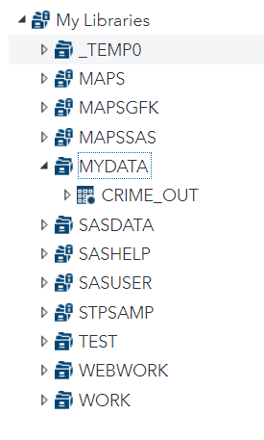
STEP 2: ACCESSING DATA / DATA IMPORT
Using Proc Import function, we first pull the xlsx file into our library.
Options Validvarname enables SAS to specify the variables follow SAS standards
The dbms function lets us chose the format our data is in.
Out function creates a library called "mydata" with the data set named "crime_out"
Lastly, we can see our data set appears in the library

Slide 5
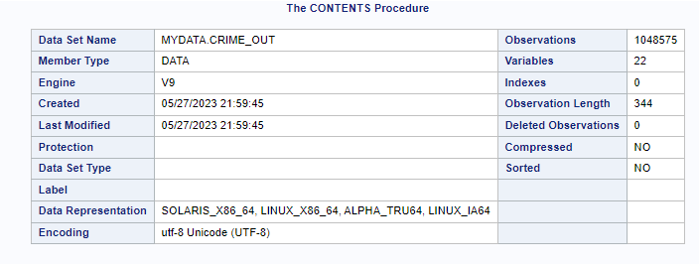

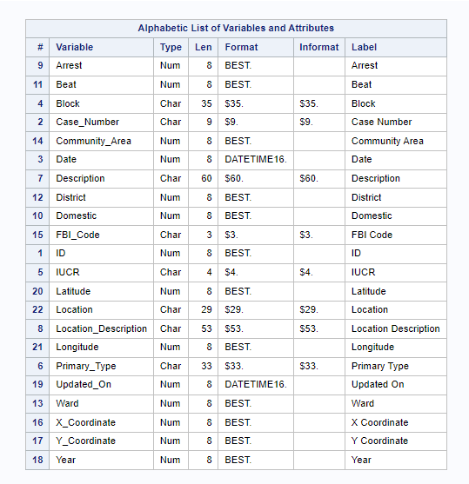
Step 3 : Data Exploration
Using proc contents, we have a glimpse of what is in the data set. For example, we can see the total observations (rows), variables (columns), data set name
One of the crucial aspect of proc contents is the being able to see the variables, its type, length of the variable, format, labels
Contents is one of the crucial steps before we start doing some data analysis/cleaning

Slide 6
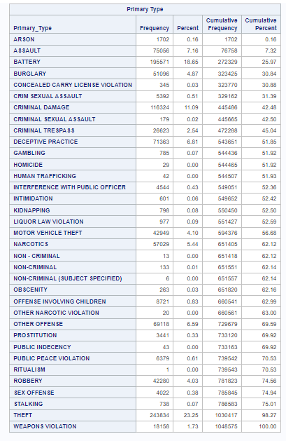
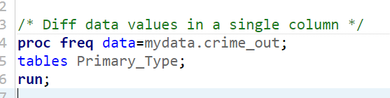
Our focus for this project is "Vehicle Theft". Hence, we will use the proc freq procedure to check for different data values within "Primary_Type" column and assess if any data value matches our interest.
We can see we have "Motor Vehicle Theft" as one of the Primary_Type

Slide 7
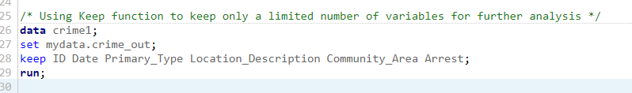
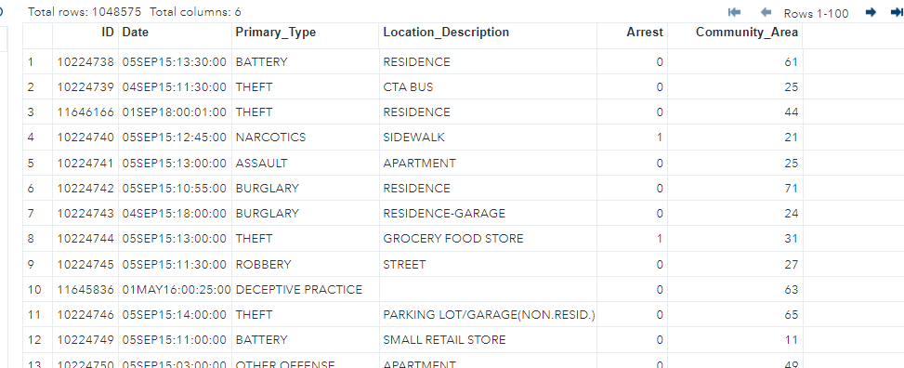
STEP 4: DATA CLEANING
Using the keep function, we keep only the variables we would be interested for our further analysis

Slide 8
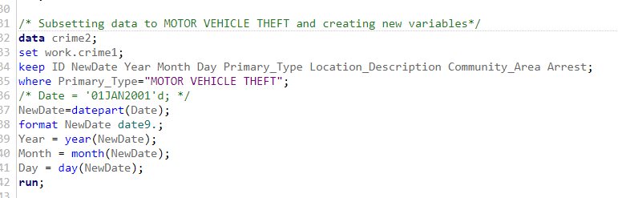
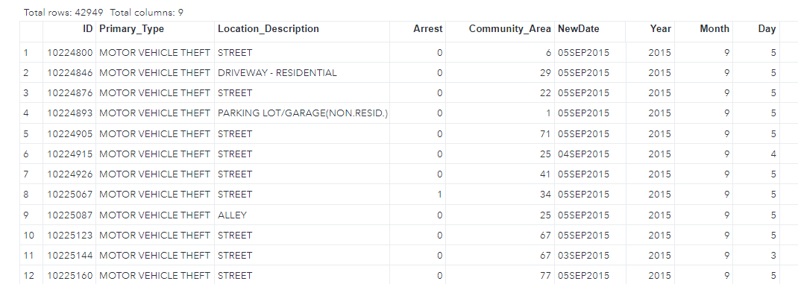
STEP 5: DATA MANIPULATION
Here we use the where statement to subset the data based on our interest "MOTOR VEHICLE THEFT"
Then we extract the date portion using datepart function and format the date to date9. format
Lastly we segregate the month, day and year using simple functions for individual analyses
We can see the changes reflecting in the Primary_Type column
We can also see the newly created variables Year, Month and Day

Slide 9
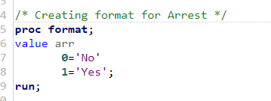
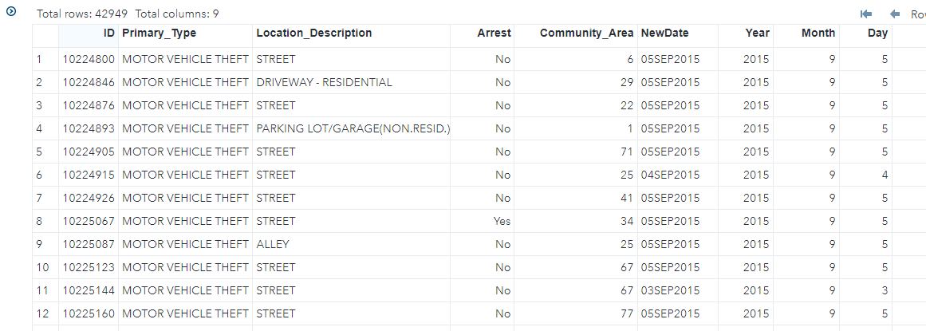
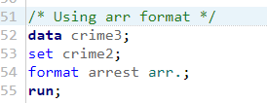
Next we use proc format to create a format to make the Arrest column eligible for presentation.
We can also use a simple IF-THEN statement
On the left top portion of the code, we first create the format
Next, in the code section below, we use the format arr
Lastly, on the right we can see the changes reflecting accordingly

Slide 10
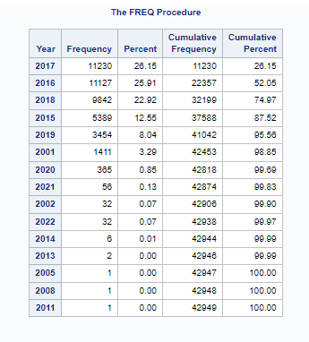
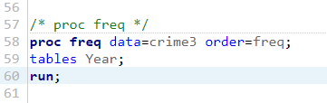
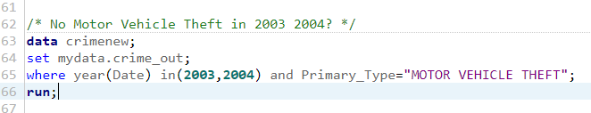
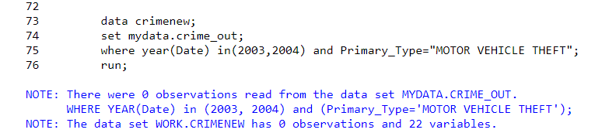
STEP 6: Data Analysis & Interpretation
Starting with brief analysis, we use the proc freq procedure to assess the highest number of car theft by year (the order function sorts the year by frequency highest to lowest)
We see years towards the end of the table having unrealistic frequency.
This might be and error within the data?
We can use the where statement and in function to include all the years we see no crimes occurring.
Our log output says we have 0 observation.
We can further check the original data and act as per directions by the manager

Slide 11
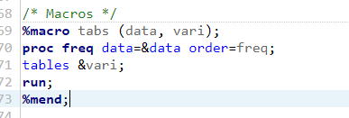



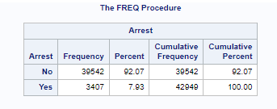
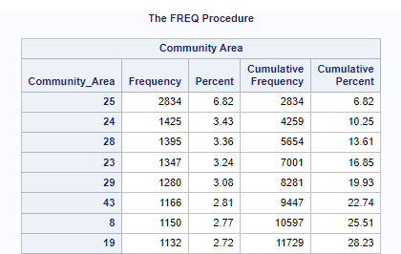
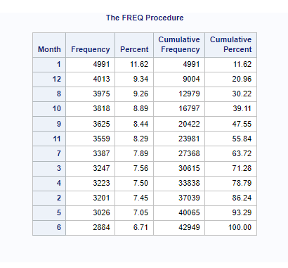
Lastly we use a simple macro function to create a macro which makes our code less complicated to execute with different variables.
First step involve creating the variables for data and variables
The next step involve calling the macro with data dataset name and the variable of interest. Only changes in the second portion of the macro needs to be changed based on our variable of interest.

Slide 12
INSGHTS?
There have been 35 different types of crimes reported
42949 cases were reported in the city of Chicago during the year 2001 to 2022
Only 3407 arrests were made which equates to 7.93%
2017 saw the highest number of car thefts with 11,230 case
Community Area 25 with 2835 cases and frequency percentage of 6.82% is the worst hit neighborhood in the city of Chicago
December and January are the most vulnerable months for car thefts

